Slide 1
PLC Tags and Data Blocks
Siemens
© 2021 John Sefcovic

Slide 2
Tags
A Tag is a Name for a Data element in the PLC Application.
PLC Tags are name assigned to the Input and Output Hardware Addresses.
Data blocks contain Tag names for additional Data for the PLC applications. These Tags are not associated with the PLC’s Hardware. Data block Tags are Global and accessible to any programming block.
A Function is a Programming Blocks that contain Logic instructions. Data Tag Names called Instances are defined in the Function Programming Block. The Instances are Local tags, accessible only to the programming block where they are defined. These Tags are not associated with the PLC’s Hardware.

Slide 3
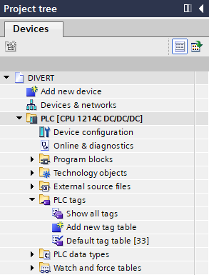
PLC Tags
PLC tags define the Hardware Input and Output Addresses to a Tag name.
The PLC tag Table is accessed from the Project tree, PLC tags and Default tag table.
PLC tags are Global tags, accessible to any programming block.

Slide 4
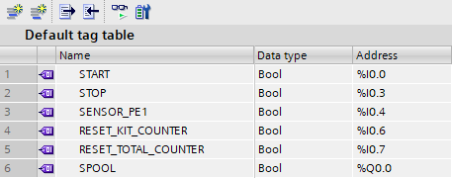
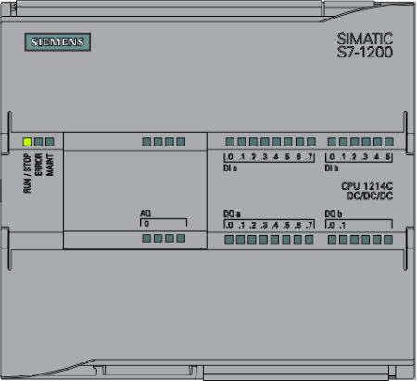
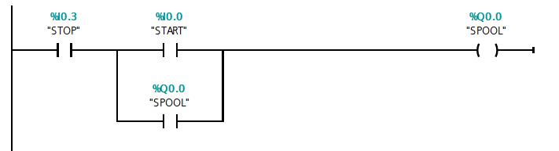
PLC Tags
The PLC tags define the Input or Output Hardware Address…

Slide 5
PLC Tags
… to the descriptive Tag Name for the Input or Output Boolean Data type.

Slide 6
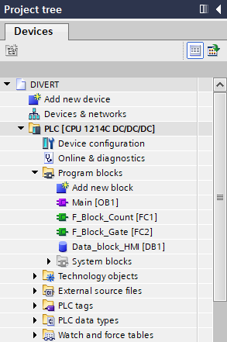

Data Block Tags
The Data Block tag Table is accessed from the Project tree, Program blocks and the named Data block.
Data blocks contain additional Data Tags not associated with the PLC’s Hardware.
These tags are additional data used to sequence and control the PLC application.

Slide 7
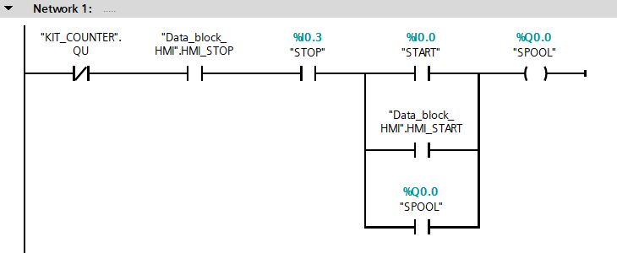
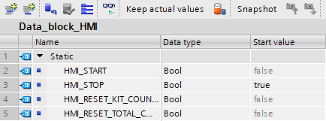
Data Block Tags
Data Block Tags are Data Tag Names that are defined in the Data Block and are Global tags, accessible to any programming block.

Slide 8

Local Program Block Tags
Functions are Programming Blocks that contain Logic instructions.
The Instance tag Table is accessed from the Project tree, Program blocks and the named Function.
Function Instance Tags are additional Data Tags not associated with the PLC’s Hardware.
These tags are additional data used to sequence and control the PLC application.

Slide 9
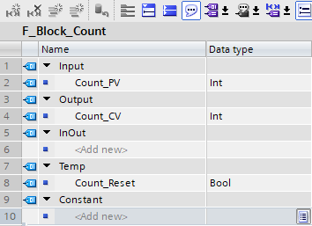
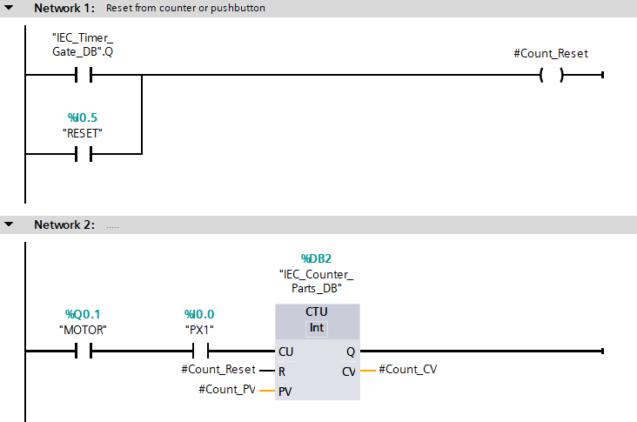


Data Block Tags
Instances are Data Tag Names that are defined in the Programming Block and are Local tags, accessible only to the programming block where they are defined.

